Slide 1

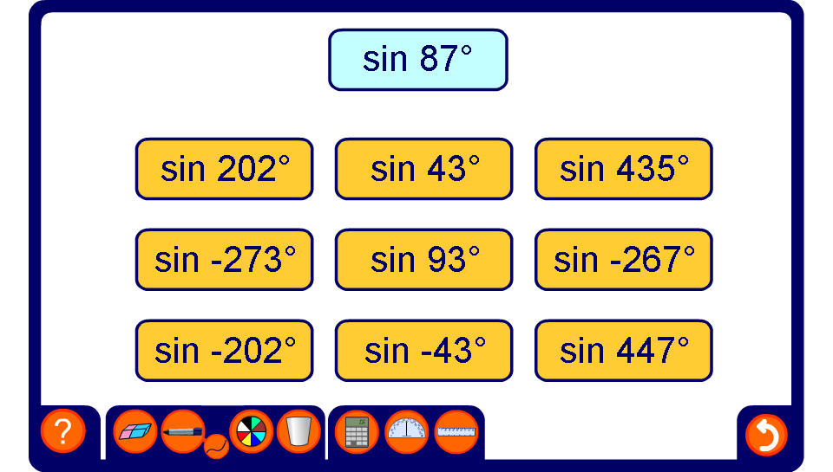


Find the equivalent ratio
Notes:
For each example find three equivalent ratios.

